Slide 1
Zowe Overview

Slide 2

Introducing Zowe
An extensible framework for connecting applications and tools to mainframe data and applications.
Aims to make the mainframe an integrated and agile platform within the changing IT architectural landscape.
First open source project on z/OS. All code is licensed under the Eclipse Public License version 2.0

Slide 3
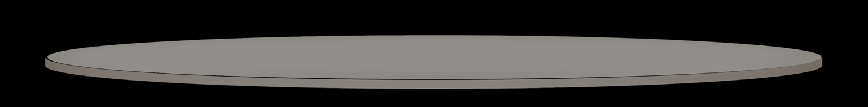
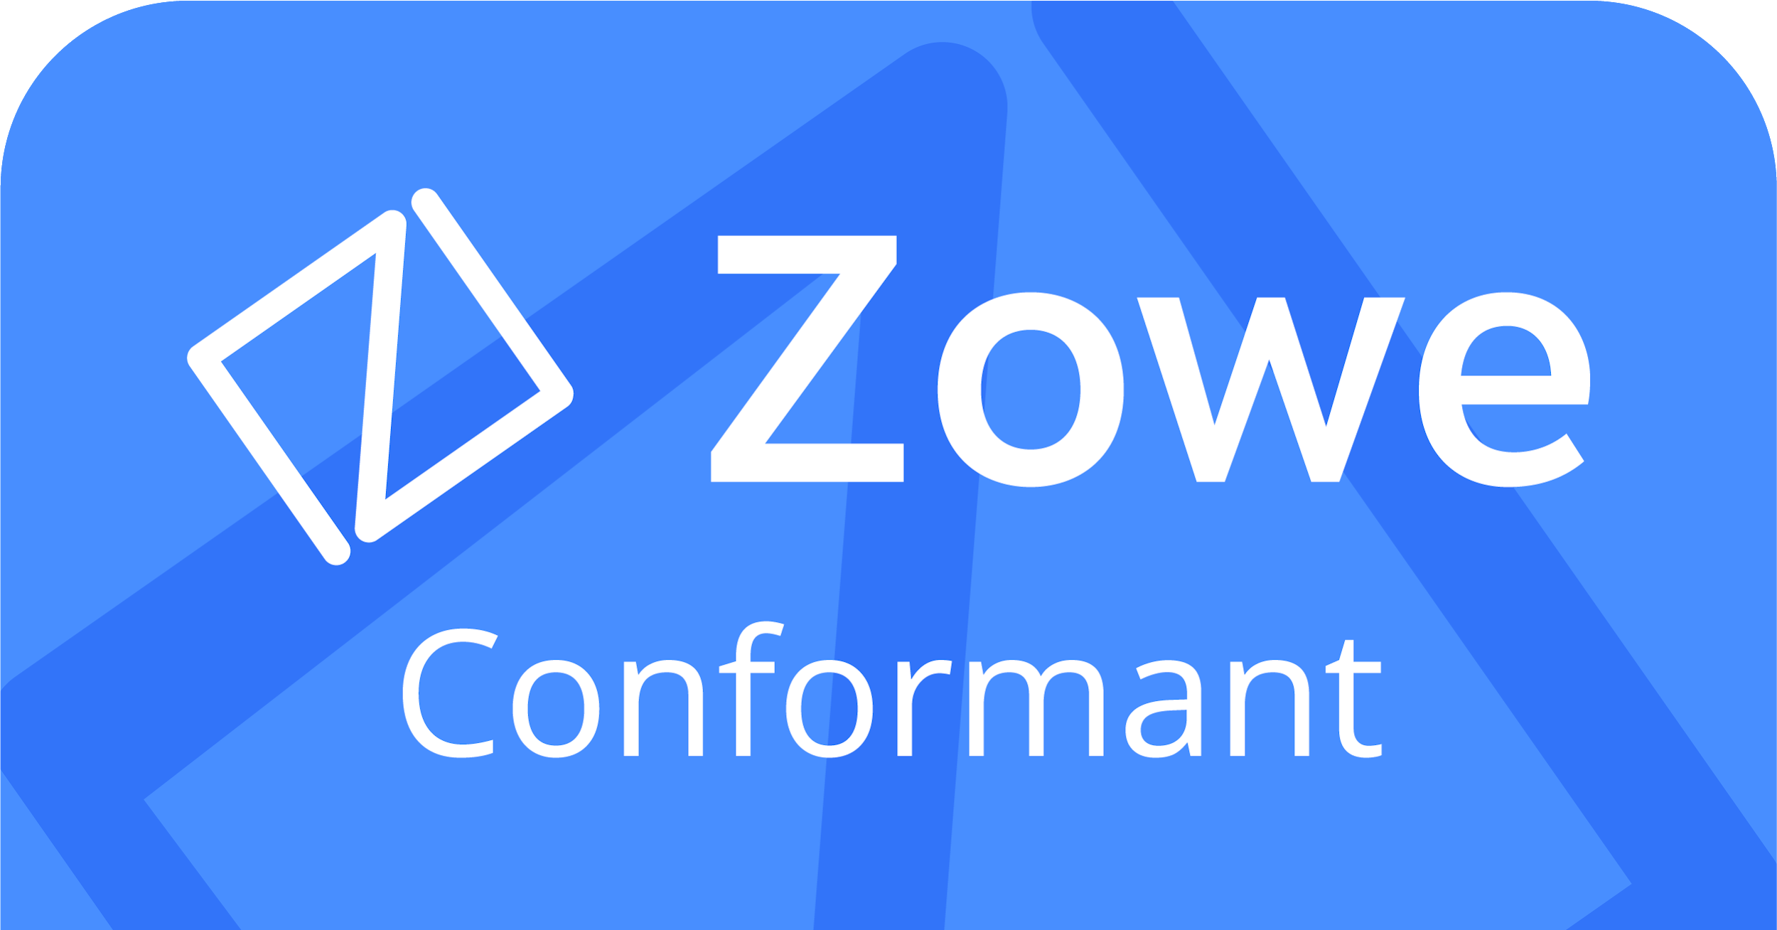
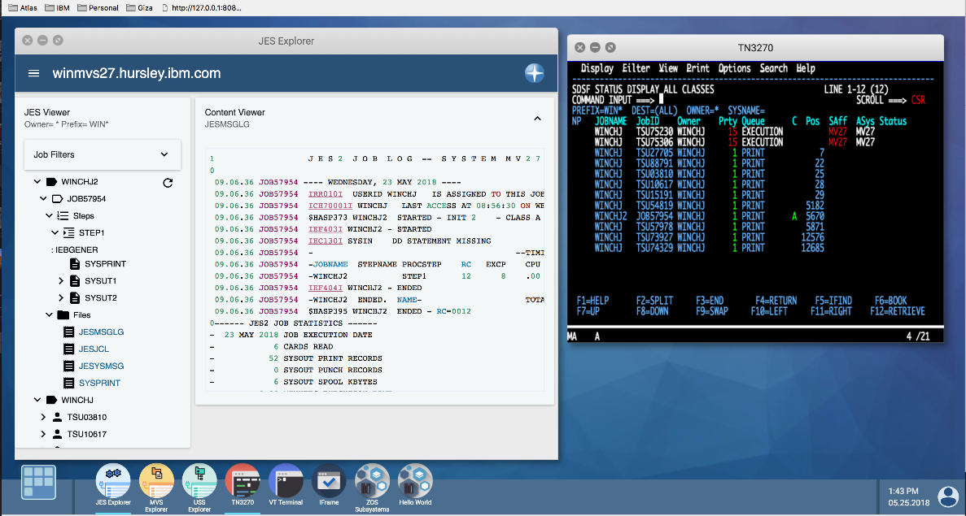
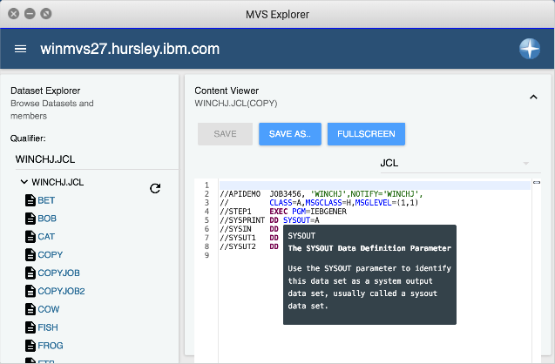

Zowe framework and ecosystem at a glance
Microservices
API Mediation Layer
CLI
App Framework
Plugins
CODE
DEPLOY
Plugins
PLAN
Plugins
BUILD
RELEASE
OPERATE
Plugins
TEST
MONITOR
Plugins
Plugins
Notes:
What this slide will communicate:
Zowe framework
What is Zowe? How do we see the organization and project develop over time?
What are the architectural design considerations and standards?
What are the initial core technologies/IP? Show the Stack. Show a roadmap
What is each founding member bringing to the table?
What is the take-away from this slide?
The initial contributors IBM, CA, and Rocket as the initial contributors members are committed to investing/extending core technologies and standards to move this project forward. We also are committed to aligning our future product portfolio development for the mainframe to adopt this open framework. The Zowe framework offers industry standard REST APIs, API Mediation Layer, an extensible command line interface and an extensible Web-based UI framework and motif.

Slide 4
Ecosystem enablement thru Zowe Conformance
Vendors are able to build applications that leverage or build on top of the Zowe Framework
Building on this framework speeds up vendors time to market and enables easier integration with other Zowe Conformant applications
Complimentary participation for any Open Mainframe Project member organization
More details at https://www.openmainframeproject.org/projects/zowe/conformance

Slide 5



Getting started with Zowe
Sign up to the Zowe email lists
User List:
https://lists.openmainframeproject.org/g/zowe-user/
Developer List:
https://lists.openmainframeproject.org/g/zowe-dev/
Find other users and developers on Slack
https://slack.openmainframeproject.org
Channels: #zowe-user and #zowe-dev
View the code and contribute
https://github.com/zowe
Contribution Guidelines at
https://github.com/zowe/community#contribute

Slide 6
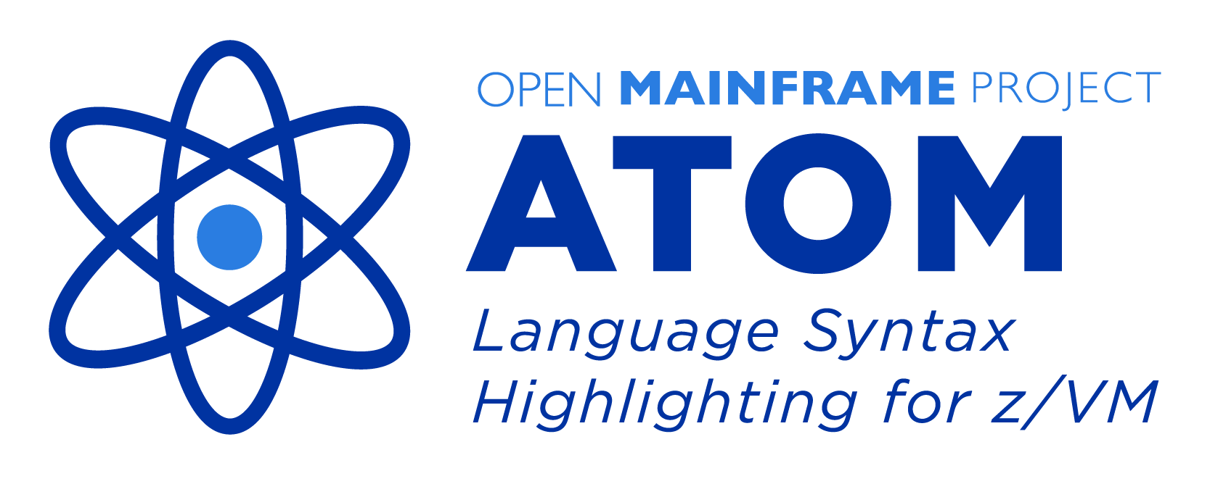





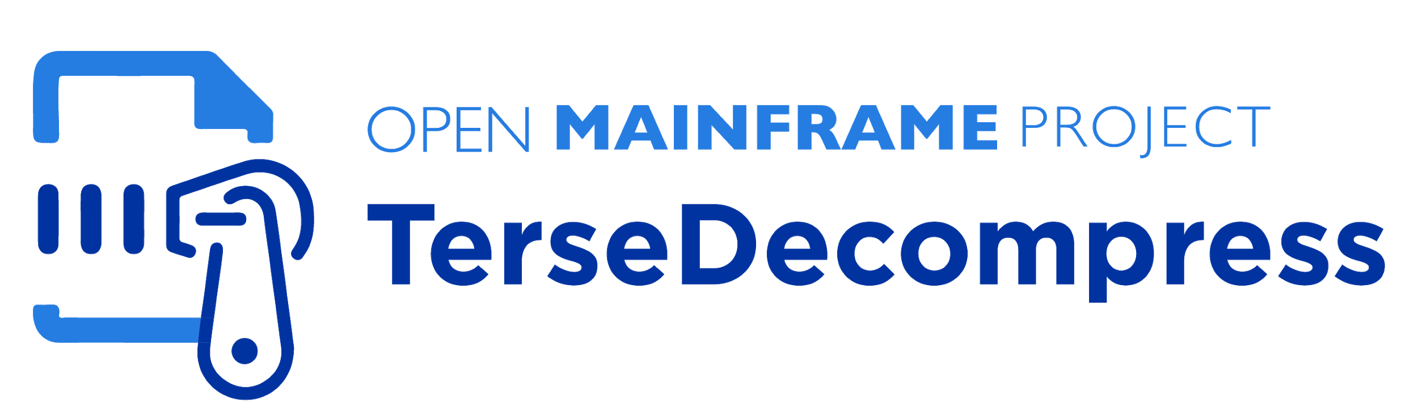
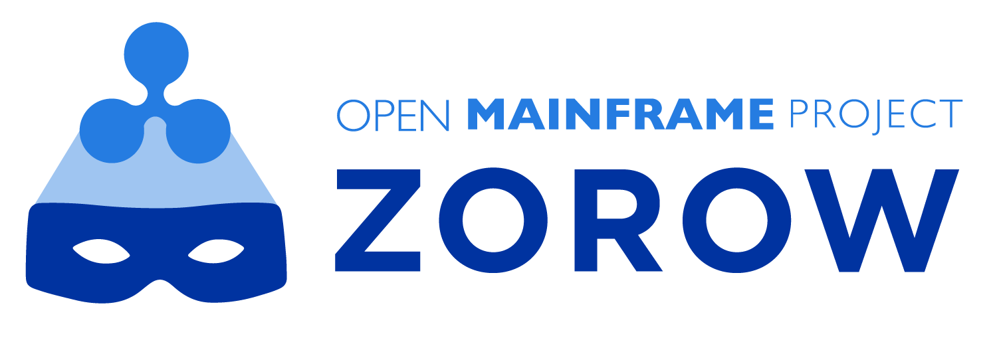
Zowe is part of the Open Mainframe Project hosted projects ecosystem
Learn about all Open Mainframe projects at https://www.openmainframeproject.org/projects

Slide 7



























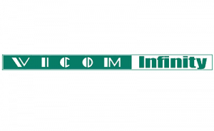



Sustainability in open source on mainframe happens thanks to Open Mainframe Project member support
Zoss Team, LLC

Slide 8


Learn more about the Open Mainframe Project
Find out more and subscribe to our newsletter at www.openmainframeproject.org
Check out our projects at https://www.openmainframeproject.org/projects
See the full landscape of open source on the mainframe at https://l.openmainframeproject.org
Organizational membership opportunities at https://www.openmainframeproject.org/about/join or email at membership@openmainframeproject.com

Slide 9
Extra slides

Slide 10
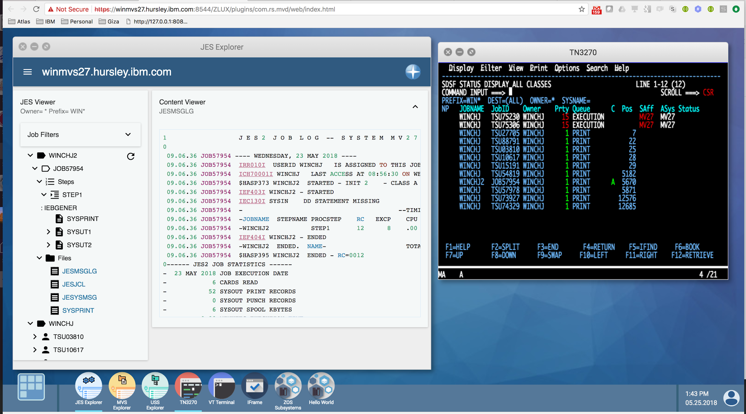
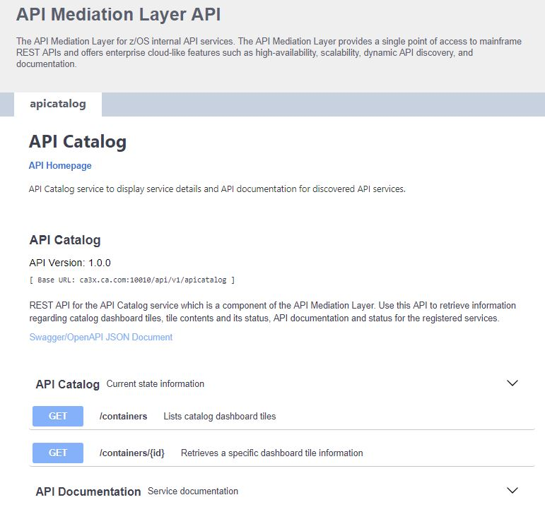
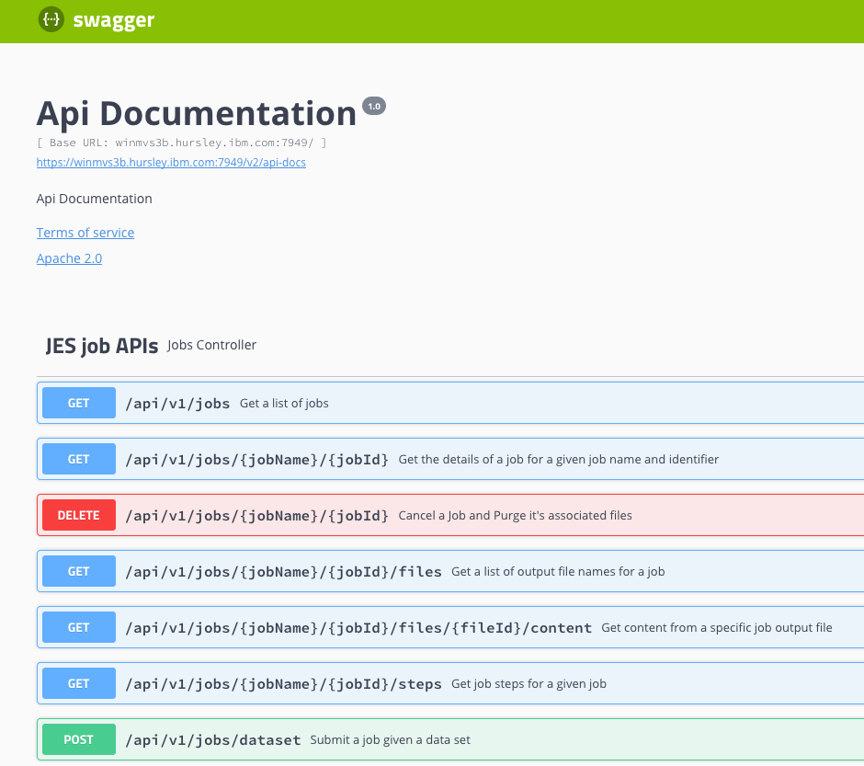
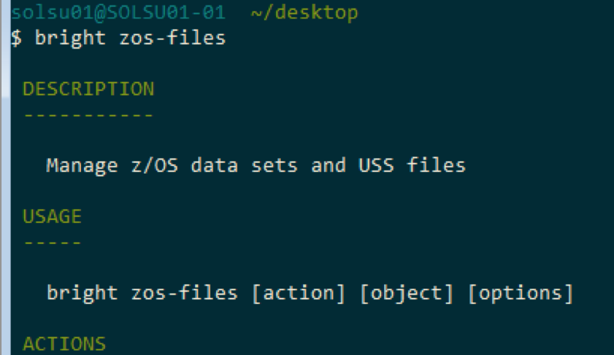
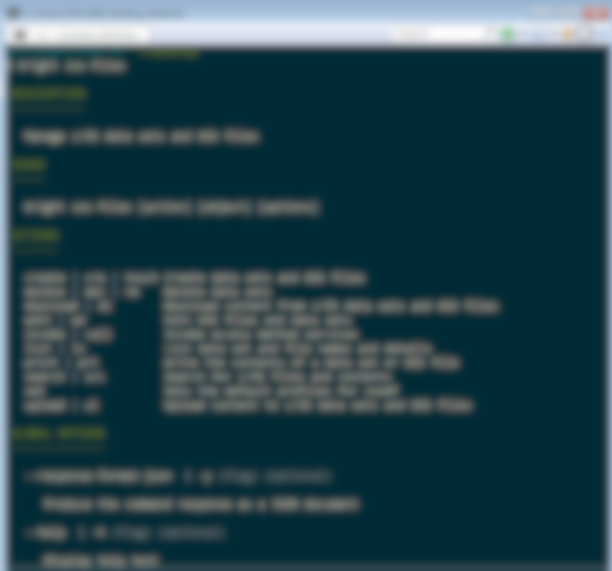
What’s in Zowe?
API Mediation Layer
(Gateway, Discovery Service, Catalog)
Browser-based Web Desktop
Swagger-defined z/OS REST APIs
Node.js- based CLI

Slide 11

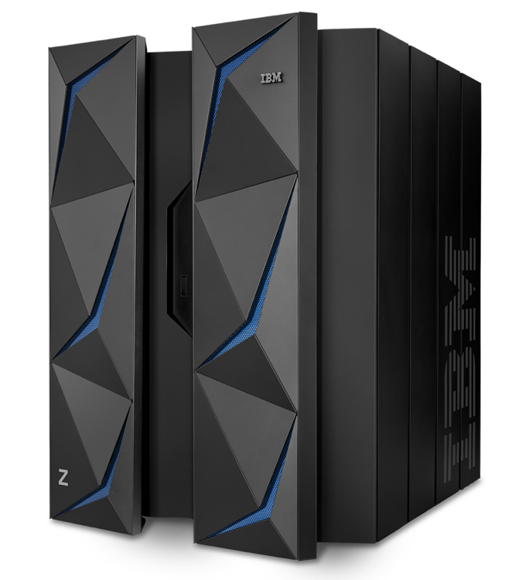
REST Services – API economy for deep integration
Industry standard REST interfaces to z/OS resources that are language and platform neutral, stateless and scalable
Foundational building blocks for system services
Zowe REST APIs
Dataset APIs
Create, read, update, delete, and list data sets
JES APIs
View the information and files of jobs, and submit and cancel job
USS APIs
Create, read, update, and delete USS files
System APIs
View information about PARMLIB, SYSPLEX, and USER
Zowe Common
Services & APIs
Vendor
Services & APIs
Client-provided Services & APIs
z/OS Management Facility REST APIs
https://ibm.biz/BdYXHX
Notes:
z/OS MF REST API Services
Application Linking Manager interface
Application server routing
Clipboard (saving data to be passed from App to App)
Cloud Provisioning (CICS, IMS, WAS, …)
Console Services
Data persistence
Data Set and file REST interface
Development Services
Information retrieval
Job Management
Multisystem routing
Notification (e-mail, SMS, …)
Software management
System Variable Services
Topology services
TSO/E address space
WLM Resource Pooling
Workflow

Slide 12
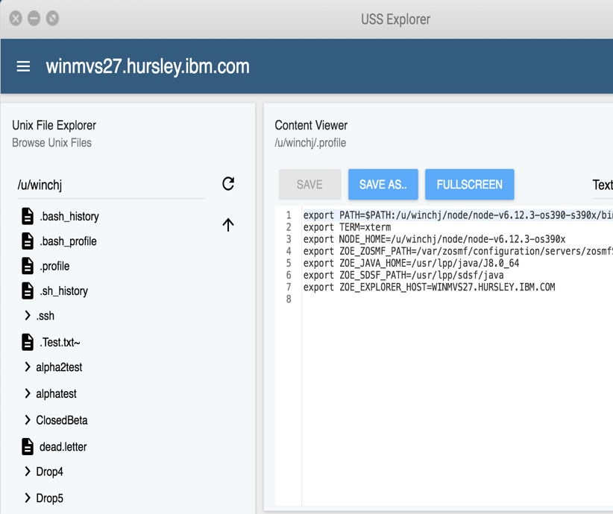
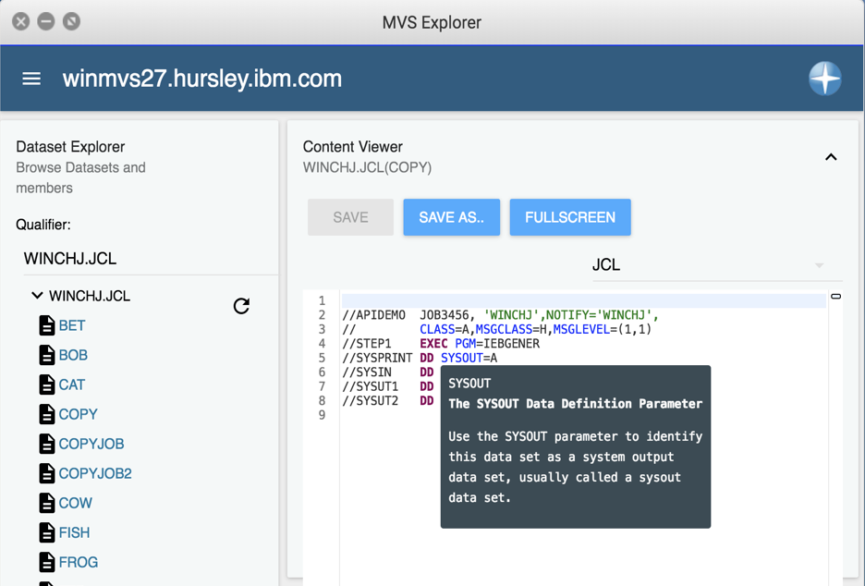
Web Desktop – An app container in a browser
Known as zLUX, the Zowe Web UI is a virtual desktop system that offers a rich and open platform for a web-based mainframe user experience.
Mainframe Virtual Desktop
A web-based window manager that provides full screen interactive experience
Zowe Node Server
Runs zLUX; uses Express.js as web service framework for communication between applications and z/OS services and components, pre-reqs Node.js for z/OS
ZSS Server
Provides secured REST API services
Application plug-in
Dataservices, Configuration dataservice, URI broker, app-to-app communication, Error reporting UI, Logging utility
Explorers
JES, MVS, USS explorers
Basic editing support for REXX and JCL
Notes:
JES Explorer
Browse jobs by filter.
User, name, status, type, return / abend code
Expand job to show file and step names
View job files to show content
Actions: Cancel, Purge, Hold, Release
If job is active file contents auto refresh
View system log
MVS Explorer
Browse MVS files status using mask
Allocate and Allocate Like PDS
Create PDS Member
Delete PDS
Delete Member
Migrate Data Set
Recall Data Set
Submit as Job PDS member and sequential data sets
View Data Set Member or sequential data set content
Edit PDS Member or sequential PDS file content: Render content for JCL and REXX
USS Explorer
Browse USS Folders and Files in navigator with filter
Create Folders and Files
Delete Folders and Files
View file content
Edit file content: Render content for javascript
Compare two files
Unix shell

Slide 13
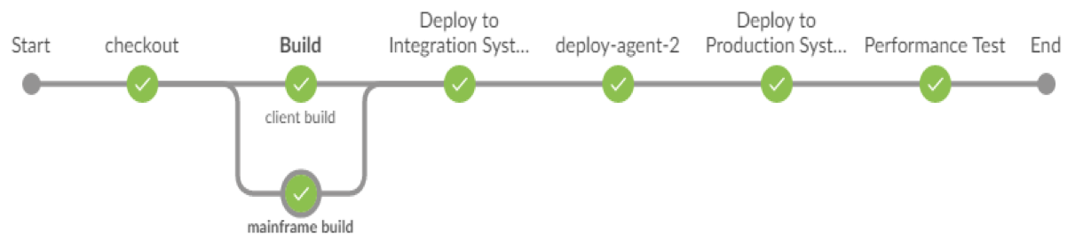
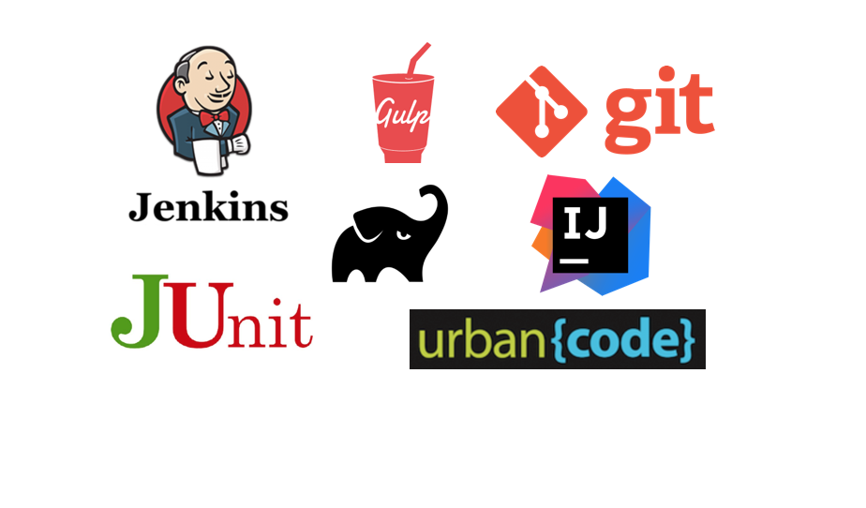
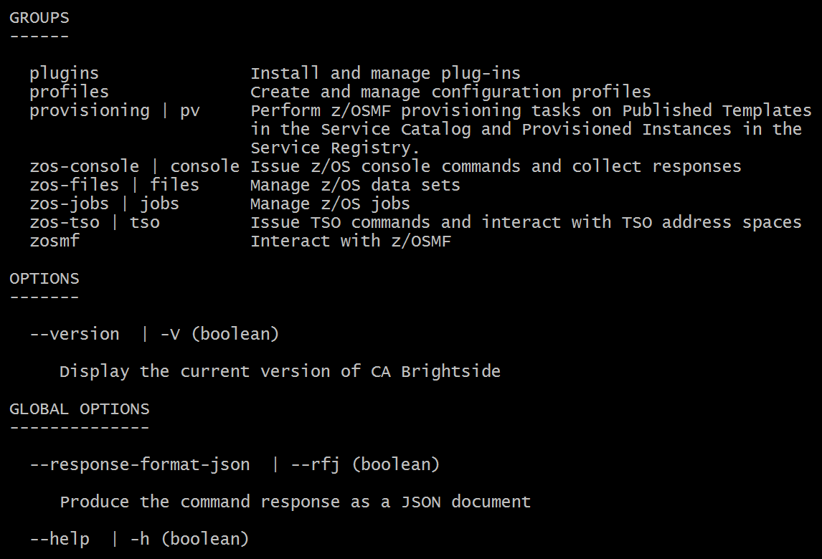
CLI – Enables cloud-like access to mainframe
Enables app developer and DevOps engineers to interact with the mainframe easily through a CLI from any terminal on Windows, MacOS, Linux
Easily integrates with IDEs, shell commands, bash scripts, and build tools; installs using NPM
Build | Test | Deploy
Interact with mainframe files Create, edit, download, and upload mainframe files (data sets) directly
Submit jobs Submit JCL from data sets or local storage, monitor status, view and download output automatically
Issue TSO and z/OS console commands Issue TSO and console commands to the mainframe directly
Integrate z/OS actions into scripts Build local scripts that accomplish both mainframe and local tasks
Produce responses as JSON documents Return data in JSON format on request for consumption in other programming languages
CLI Plug-Ins Access to CICS and DB2

Slide 14
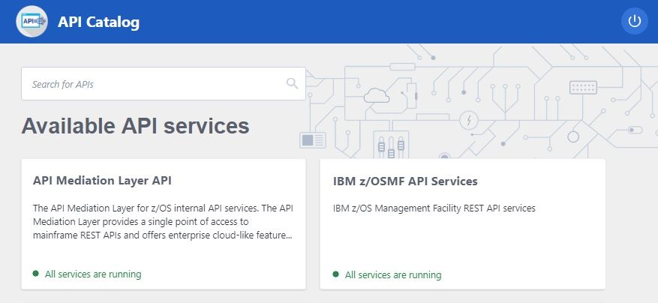
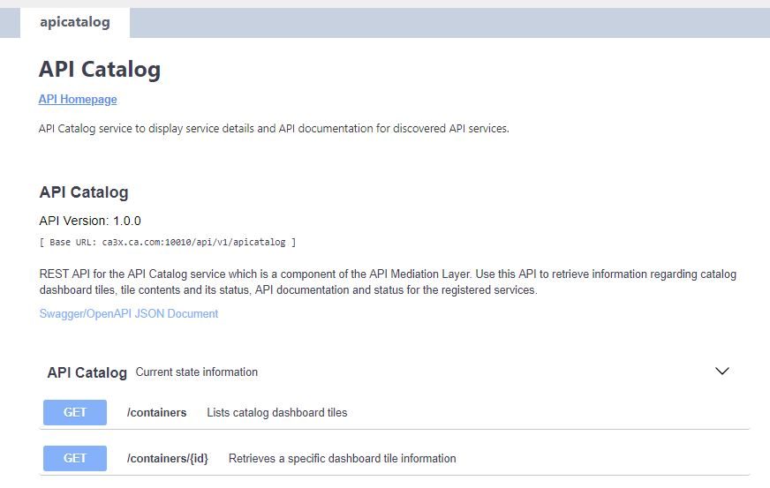
API Mediation Layer – Gateway to mainframe APIs
Enables a single point of access to mainframe APIs with high-availability, scalability, dynamic API discovery, consistent security, “one-time” sign-on experience and unified standard API documentation (OpenAPI / Swagger)
API Catalog UI Catalog of available APIs with their Swagger doc and service status
Gateway Single secure point of entry to an ecosystem of API services. Hides complexity. Highly available. Based on Netflix Zuul.
Discovery Service Discover APIs across many applications. Repository of active API services. Based on Netflix Eureka.

Slide 15
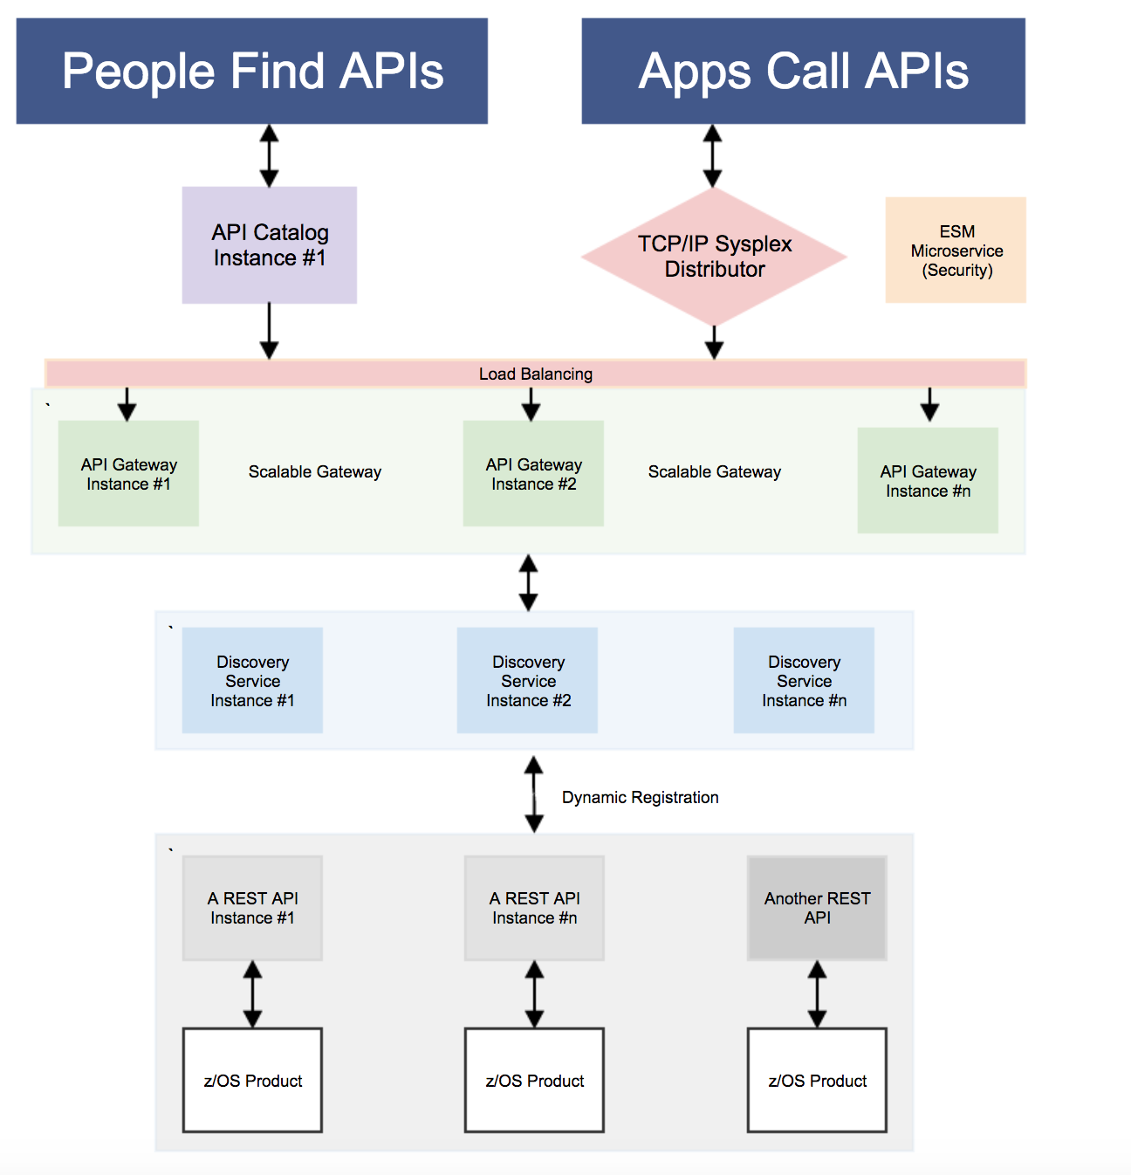
My Flow Diagram from Giza
API Layer Components*
API Catalog UI Catalog of available APIs with their Swagger doc and service status
API Gateway Single point of entry to an ecosystem of microservices. Hides complexity. Highly available. Based on Netflix Zuul.
Discovery Service Discover APIs across many applications. Repository of active services. Based on Netflix Eureka.
z/OSMF API Authenticate Zowe users with mainframe credentials
* Separate microservices, might be running as separate address spaces
z/OS Connect
z/OSMF
Jax-RS App
‹#›

Slide 16
Zowe High Level Architecture
Base Components
Editor support (REXX/JCL to start)
CLI
APIs
Virtual Desktop – App Container
VS Code Extension
Browser/
Desktop
Web UI
CLI UI
VSC Ext.
REST API
Web-Based DevOps Services
From IBM, Vendors, Community
RESTful Services
Catalog of RESTful API
Sample Vendor / Open Source Integration
ServiceNow
JIRA
Jenkins
Git
SonarLint
z/OS
Web UI, CLI/Node.js
Common Services
Existing and New Vendor Services
Client-Provided Services
z/OSMF/Tomcat

Slide 17
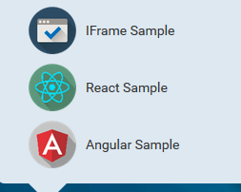
Where is Zowe Extensible?
z/OS Native Web UI for applications
Launch in context (i.e., right mouse click 3270 to web app)
App to app communication
Exploit graphic widgets planned for inclusion
Browser-based Web Desktop
‹#›

Slide 18
Where is Zowe Extensible?
Opt in to API Mediation
Participate in Single Sign On, High Availability and Status tracking capabilities
REST API enable your products
REST API for product controls/admin
Sharing of information
API Mediation Layer
(API Catalog, Discovery Service, Gateway)
Swagger-defined z/OS REST APIs
‹#›

Slide 19
Where is Zowe Extensible?
Node.js- based CLI
z/OSMF
REST APIs
TSO, Console
JES, MVS. USS
Out of box commands
zos-files DS
zos-files US
zos-jobs
TSO
Console
“plug-ins”
Your application, product, tool, …
Custom
Extensions
‹#›

Slide 20
“Demo”
Intro Demo:
https://www.youtube.com/watch?v=NX20ZMRoTtk&feature=share
Visual Studio Code (using command line):
https://www.youtube.com/watch?v=la1_Ss27fn8

